Slide 1
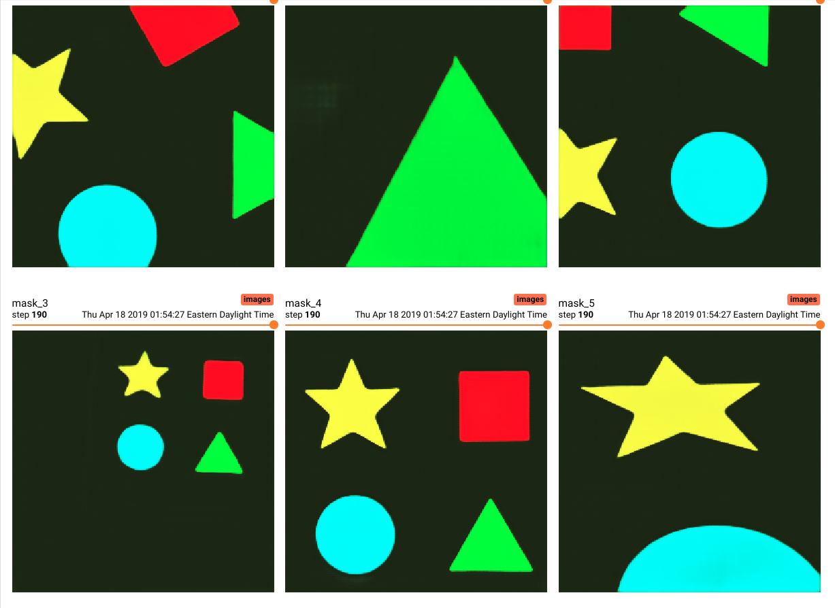
Custom Semantic Segmentation

Slide 2
Overview
Walkthrough of annotating your own images and training a semantic segmentation model. (shapes dataset is provided)
Full code can be found on github to deploy the unit tests in each video.
Beginners should follow all videos. They are as compact as possible to cover fundamentals, while avoiding writing the entire repository from scratch.
FCN-8 and UNet are currently supported (without cropping)
Tensorboard image tab to view the model as it trains!

Slide 3
Video List
Series information
Install
Ubuntu 18.04
Windows 10
Image collection
Image annotation
Binary classification masks
Multi classification masks
Hue masks
Data augmentation
Conditional random fields (CRF)
FCN-8
UNet
Training
Streaming
Walkthrough
Programming
Theory

Slide 4
Requirements
Webcam and NVIDIA GPU with compute capability >= 3.5
GPU with decent memory (4 GB)
Tensorflow-gpu dependencies (1.13)
NVIDIA driver
CUDA 10.0
cuDNN (>= 7.4.1)
Successful import of tensorflow-gpu
python -c "import tensorflow as tf; tf.enable_eager_execution(); print(tf.reduce_sum(tf.random_normal([1000, 1000])))"

Slide 5
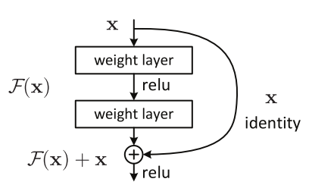
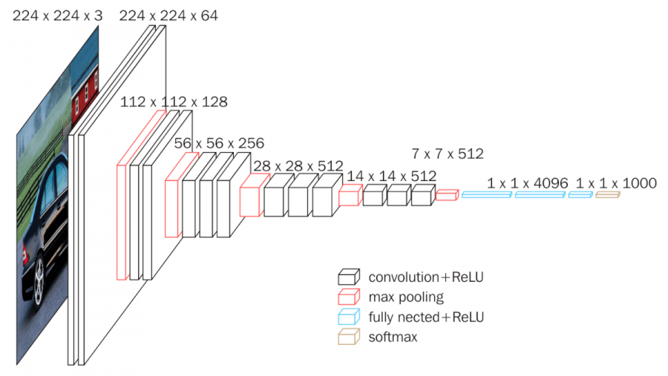
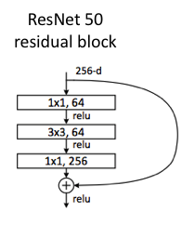
VGG 16 & ResNet 50

Slide 6
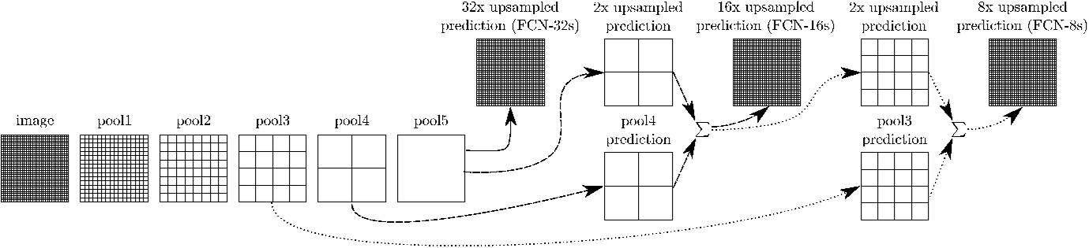
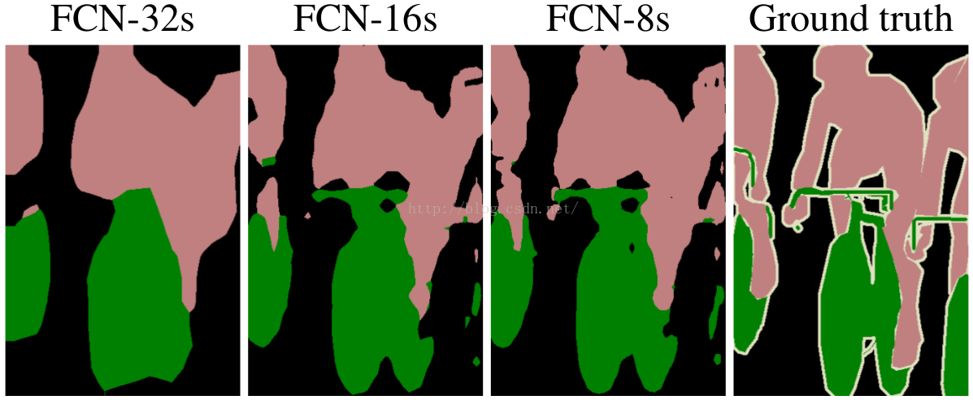
FCN (Fully Convolutional Networks)

Slide 7
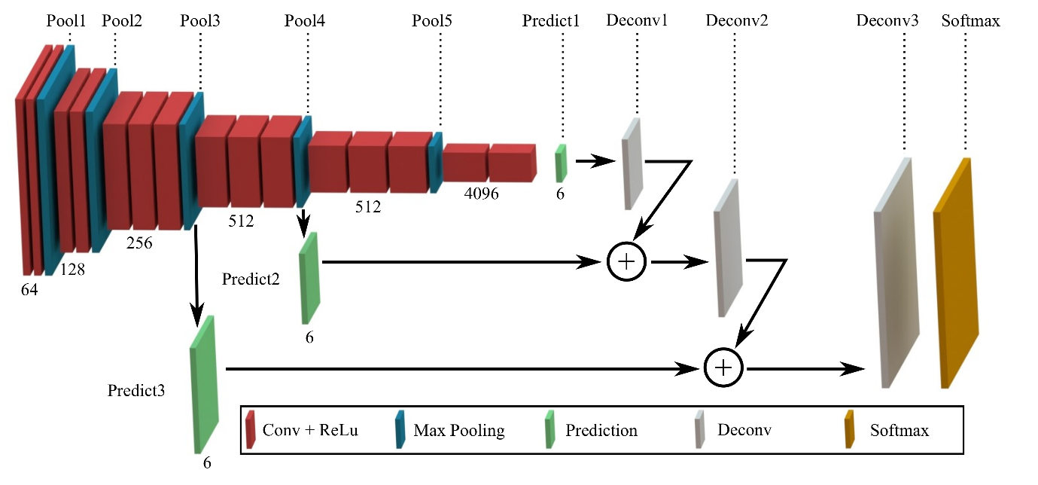
FCN (Fully Convolutional Networks)

Slide 8
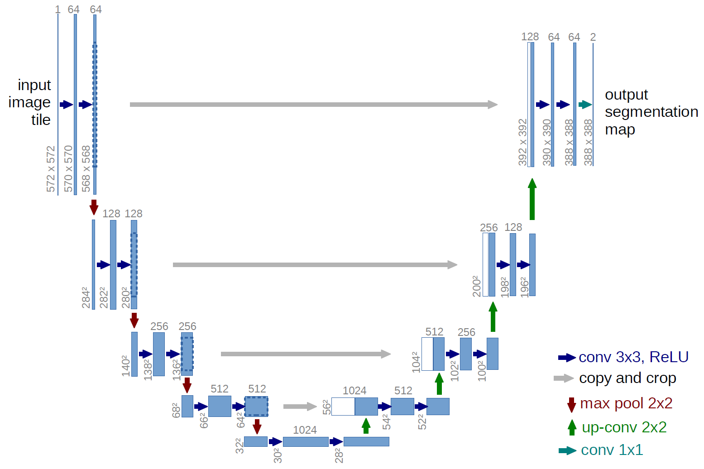
UNet

